Slide 1
01
Naan Mudhalvan
Avenash’s
Presentation

Slide 2
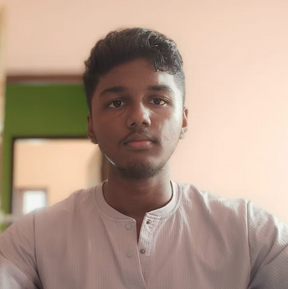
02
STUDENT NAME: K.R. Avenash
REGISTER NO AND NMID: 101A45B0DA3DA3FA65F4115F9618A1AC
DEPARTMENT: BCA
COLLEGE/ UNIVERSITY: AM JAIN COLLEGE
asunm1301212402327
24H240

Slide 3
03
PROJECT TITLE
Interactive Digital Portfolio Using Front End Web Development

Slide 4
04
AGENDA
1.Problem Statement
2.Project Overview
3.End Users
4.Tools and Technologies
5.Portfolio design and Layout
6.Features and Functionality
7.Results and Screenshots
8.Conclusion
9.Github Link

Slide 5
05
Problem Statement
In today's competitive digital landscape, individuals often struggle to effectively showcase their skills, work, and personal brand online. Without a personal portfolio, it's difficult to stand out to potential employers, collaborators, or clients. The lack of a centralized, visually appealing, and professional platform limits career opportunities and personal branding.

Slide 6
06
Project Overview
This is a single-page, responsive, and interactive personal portfolio website. It features multiple sections that users can navigate through a fixed-position navigation bar. The site introduces the developer, details their skills, showcases key projects, and provides a contact method, all within a clean, modern design.

Slide 7
07
End Users
Recruiters and hiring managers looking to assess technical and creative skills
Clients or businesses interested in digital marketing, automation, or web development services
Collaborators or peers in tech/startups seeking partnerships
General audience interested in learning more about my
work and skills

Slide 8
08
Tools and Technologies
HTML5 – Structuring the web content
CSS3 – Styling and responsive design
JavaScript – Interactivity (hamburger menu, scroll effects)
Wix – Used for hosting the featured project (Career Finder)
Fonts – ‘Poppins’ font for modern typography
Gradient and Shadow Effects – For modern visual design
Responsive Design – Media queries for mobile support
Font Awesome - An external library is used to provide social media icons.
External Assets - Images for the profile photo and project screenshots are sourced from a GitHub repository.

Slide 9
09
Portfolio Design and Layout
Navigation Bar: Fixed at top with links to Home, About, Work, Contact, and Skills. Includes a hamburger menu for mobile.
Hero Section: Full-screen intro with name, tagline, and call-to-action button.
About Section: Short bio and list of technical and professional skills.
Work Section: Highlight of the featured project (Career Finder), including a button linking to a live demo.
Contact Section: Simple form to collect user inquiries.
Back-to-Top Button: Floating button for better UX on long pages.
Color Theme: Dark mode with gradients and glowing shadows for a futuristic, tech-savvy feel.

Slide 10
10
Features and Functionality
Smooth Scrolling Navigation: The fixed navigation bar links allow for smooth transitions to each section of the website.
Mobile-Friendly Hamburger Menu: The menu icon appears on smaller screens, toggling the navigation links for a clean, mobile-optimized experience.
Image Modal (Pop-up): Clicking on the profile photo or any project image opens a full-screen pop-up of the image, allowing for a closer look.
Responsive Project Grid: The "Mini Projects" section uses a CSS Grid to display projects in a neat, responsive layout that automatically adjusts based on screen size.
Contact Form: A basic, functional contact form with required fields for user submissions.
Back-to-Top Button: A button appears in the bottom-right corner when the user scrolls down, offering a quick way to return to the top of the page.
Social Media Integration: Links to GitHub and Instagram are included, using Font Awesome icons for a professional look.

Slide 11
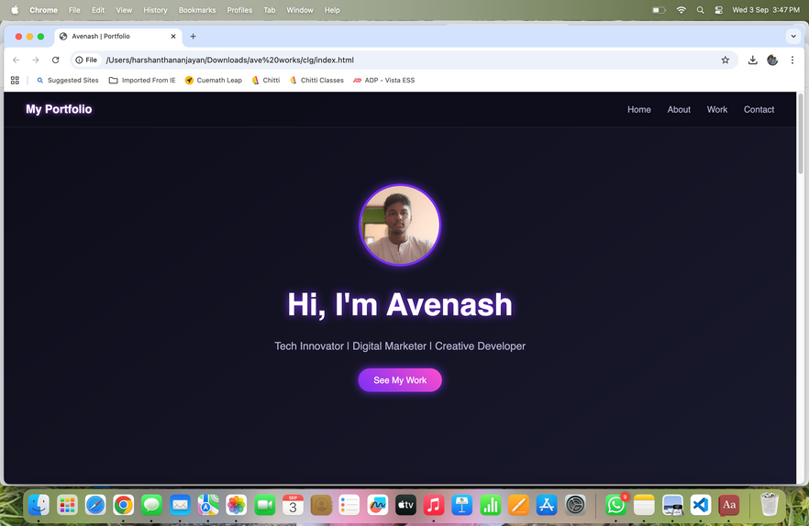
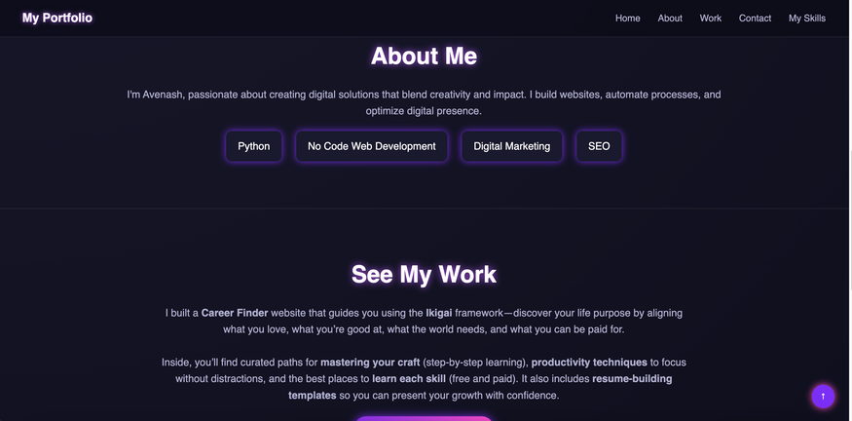
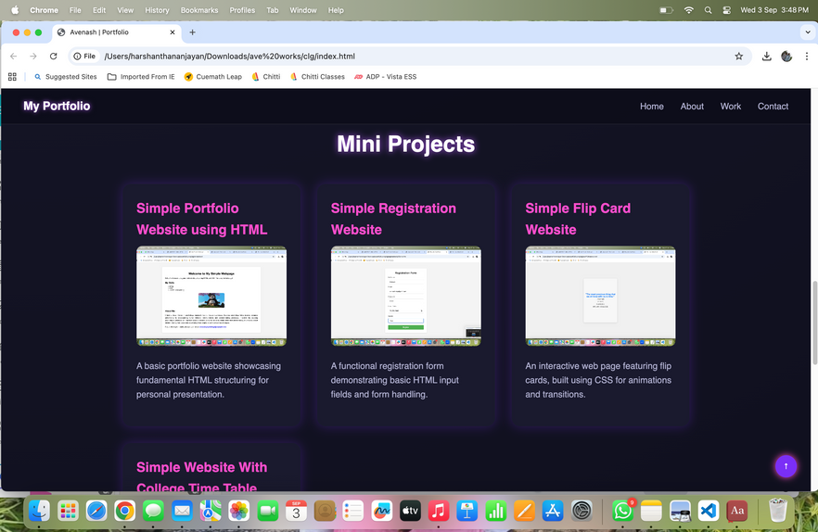
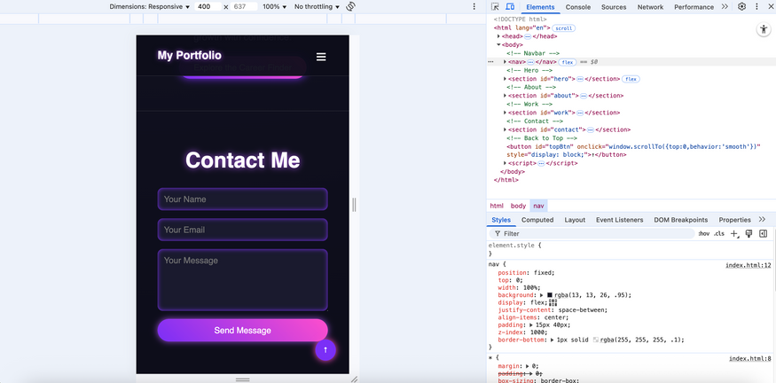
11
RESULTS AND SCREENSHOTS

Slide 12
12
Conclusion
This personal portfolio project effectively showcases my skills, creativity, and professional experience in a visually engaging and user-friendly manner. With a clean layout, responsive design, and interactive features like smooth scrolling and a mobile-friendly menu, it serves as a powerful digital identity. By highlighting key strengths and a featured project, it not only builds personal branding but also opens doors to career opportunities, collaborations, and client engagements.

Slide 13

13
Github Link:
https://github.com/avenash-amjc/TNSDC-FWD-DigitalPortfolio.git

